Slide 1
General anesthesia
Dr.Alaa A. Ibrahim

Slide 2
Anesthesia ( Greek term anesthesia meaning "insensibility,“) is used to describe the loss of sensation to the entire or any part of the body.
Anesthetics are Drugs that depress the activity of nervous tissue locally, regionally, or within the CNS.
General anesthesia is defined as complete unconsciousness, insensitivity to pain, muscle relaxation,
Surgical anesthesia: Is the state/plane of general anesthesia that provides unconsciousness, muscular relaxation, and analgesia sufficient for painless surgery.

Slide 3
Reasons for Administering Anesthesia
Alleviate pain and induce muscle relaxation, essential for safe surgery.
Control of animal
Safe transportation of wild and exotic animals
Diagnostic and therapeutic procedures
Euthanasia
Human slaughter of human food animals

Slide 4
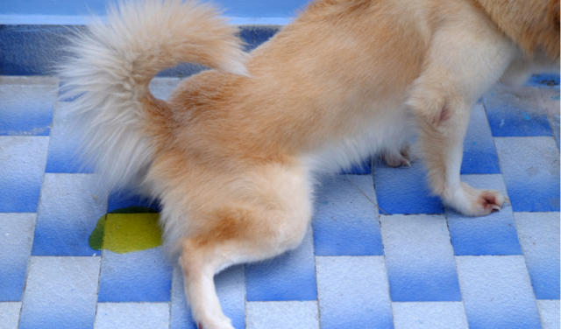
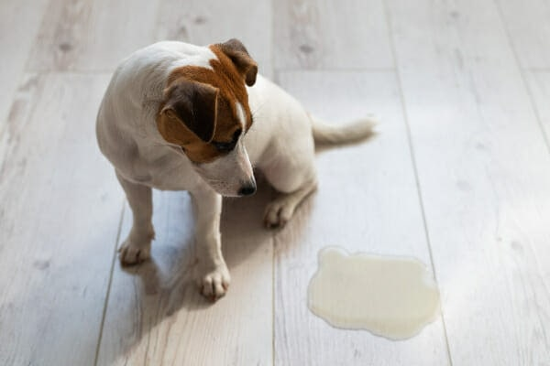
Stages of general anesthesia
Stage of voluntary movement
Start from administration of anesthetic to loss of consciousness and Some analgesia may be present in this stage ,
Nervous animals are bound to resist restraint
Excited animals may struggle violently and voluntarily hold their breath for short periods
Strong and rapid heartbeat and pupillary dilation due to Epinephrine release
Salivation , urination , and defecation are frequent in some species

Slide 5
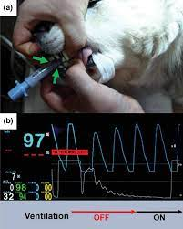
Stage II(stage of delirium or involuntary movement )
Animal loss all voluntary control as the CNS become depressed
This stage starts from loss of consciousness to the onset of a regular pattern of breathing .
Patients react to external stimuli by violent reflex struggling, breath holding, tachypnea, and hyperventilation.
Fast and strong heartbeat , cardiac arrhythmia , widely dilated pupil
Nystagmus commonly occur in horses.
Animals may whine, cry, bellow, or neigh,

Slide 6
Stage II(stage of delirium or involuntary movement )
Excessive salivation in ruminants and cats
Vomiting in dogs, cats , and goats.
The larynx of cats and pigs is very sensitive at this stage, and stimulation may cause laryngeal spasms.
Jaw tone is still present, and attempts at endotracheal intubation are met with struggling and may initiate vomition in dogs and cats and active regurgitation in ruminants.
Because of the exaggerated reflex responses during this stage, stimulation of any kind should be avoided

Slide 7
Stage III (stage of surgical anesthesia )
This stage is characterized by unconsciousness with progressive depression of the reflexes.
Muscular relaxation develops, and ventilation becomes slow and regular. Vomiting and swallowing reflexes are lost.
This stage can be divided into 3 planes :-
Light anesthesia persists until eyeball movement stop.
Medium anesthesia stable respiration and pulse rate, absent of the following reflexes laryngeal reflex , palpebral reflex, corneal reflex, and adequate muscle relaxation and analgesia for most surgical procedures
Deep anesthesia decrease intercostal muscle function, profound muscle relaxation, diaphragmatic breathing and centered and dilated pupil

Slide 8
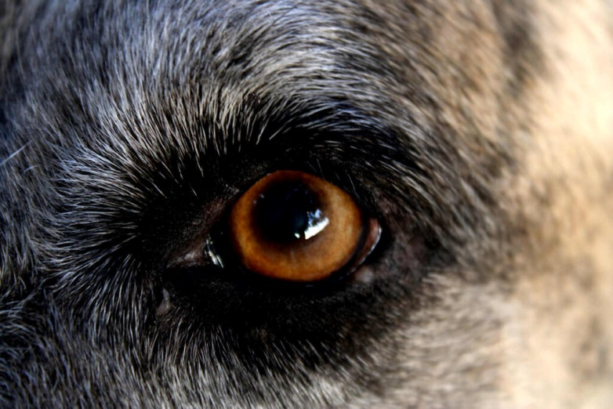
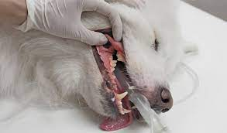
Stage IV (overdosage)
The CNS is extremity depressed and respiration is cease. The heart is beat for short time and blood pressure is at the shock level
Capillary refill time is markedly delayed , and pupils are widely dilated .Anal and bladder sphincters relax
Death quickly occur unless immediate resuscitative steps are taken.

Slide 9
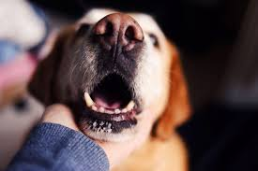
Signs of anesthesia
Respiration
Increased in stage I
Irregular and breath holding in stage II
Breathing regular and abdominal in stage III
In stage IV Completely abdominal and diaphragmatic contract cause abdominal bulge and thoracic collapse in inspiration and during expiration, the reverse occurs.
In dogs, oral and cervical movements (tracheal tugging) may be observed during this stage IV

Slide 10
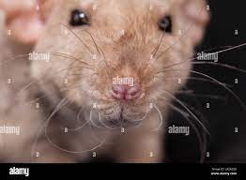
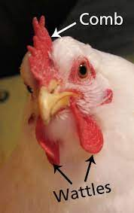
Circulation
Veterinarians often do not measure pressure, but must depend on the :
Pulse rate or bleeding at the surgical site,
Compressing an exposed mucous membrane (such as conjunctiva, oral mucosa , or tongue) to give some indication about circulatory status of the patient
Pallor M.M. as a result of hemorrhage or shock and cyanotic as a result of hypoxia

Slide 11
Circulation
During stages I and II, the pulse is strong and accelerated.
Arrhythmias sometimes occur during stage II
Regular pulse rate and usually slightly accelerate in stage III

Slide 12
Ocular signs
These include eyeball position and movement, photo motor reflexes and pupillary size, lacrimation, and palpebral, corneal, and conjunctival reflexes.
Eyeballs are generally turned downward in dogs, cats , and pigs with light and medium surgical anesthesia and eyelids are usually closed
The pupils are dilated during stage II but thereafter constrict
Reflex constriction of the pupil on exposure to light stimuli (photo motor reflex) is lost on transition from light to medium surgical anesthesia

Slide 14
Ocular signs
Eyeball movement is especially valuable in horses, in which nystagmus occurs with the onset of stage II and continues through light surgical anesthesia.
In horses, lacrimation is a consistent sign of light surgical anesthesia.
Because the eyes may also be open in deep anesthesia in horse , the cornea subject to the adverse effects of drying and ointment should be applied to the eyes anesthesia has been induced
Palpebral reflex( blink induced by touching the eyelids) lost in medium surgical anesthesia
Corneal reflex(Blinking induced by gently touching the cornea) usually lost shortly after the palpebral reflex
In horses, the corneal reflex persists into deeper anesthesia.

Slide 15
Pharyngeal and Upper-Airway Reflexes
Suppression of these reflexes is of particular importance for endotracheal intubation and for induction of anesthesia in animals, such as ruminants, with full stomachs
Coughing and laryngeal reflexes in response to intubation are lost in light surgical anesthesia, but may persist into medium anesthesia in cats
Swallowing and vomiting reflexes disappear in light plane of anesthesia but persists into medium anesthesia in cats.

Slide 16
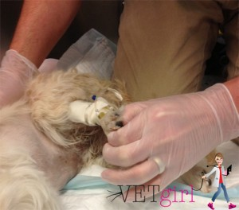
Other signs of anesthesia
limb muscles are relaxed in light anesthesia, whereas abdominal muscles are not well relaxed until anesthesia is deep
In dog stage III, passive opening of the mouth may elicit yawning
Resistance to opening the mouth fully (jaw tone )is lost in medium anesthesia.
In dogs and cats , The digital (pedal) reflex lost in medium plane
Head shaking in response to ear pinching is lost in surgical anesthesia stage in cats , rabbits , and pigs

Slide 17
Other signs of anesthesia
Anal sphincter of horses is tight in stage II but in deep surgical anesthesia it may gape to such an extent that feces can be observed in the anal canal
Horse anal sphincter gradually loses ability to contract in response to mechanical stimulation in medium to deep surgical anesthesia.
In dogs and cats ,The digital (pedal) reflex (limb is flexed in response to painful stimulation of the digits or interdigital region) is lost in medium surgical anesthesia,
Vent reflex in bird (anal reflex) remains until a deeper plane of anesthesia

Slide 18
Physical Signs of Anesthetic Depth
Spontaneous movement is a reliable sign of a light level of anesthesia with most anesthetics.
Reflex movement in response to surgical stimulation is a reliable sign of a light level of anesthesia.
Sudden increase in heart and respiratory rate in response to surgical stimulation, is a reliable sign of a light level of anesthesia.
Mandibular muscle tone should be lots, some, and none in light, medium, and deep levels of anesthesia, respectively,
A change to an abdominal (diaphragm)-first breathing pattern signals a deeper level of anesthesia

Slide 19
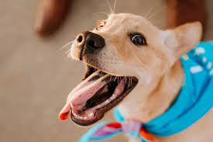
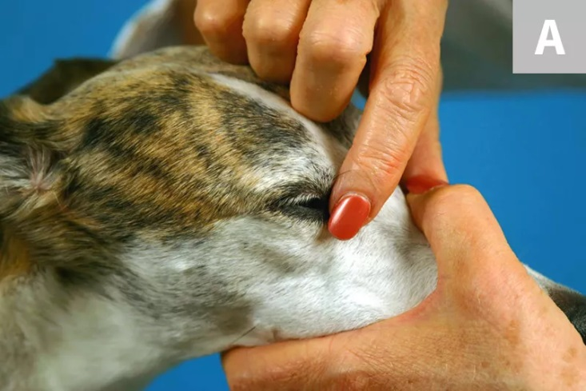
The presence of a palpebral reflex is a reliable indicator of a light level of anesthesia. The absence of it suggests a medium or deep level.
Presence of pupillary light reflex (constriction in reponse to light) and dazzle reflex( blink in response to bright light ) light to medium level of anesthesia
Eyeball central (pupil medium size ) in light level and ventromedial in medium level and again central in deep level
Presence of gag reflex and swallowing is signs of light level

